Slide 1
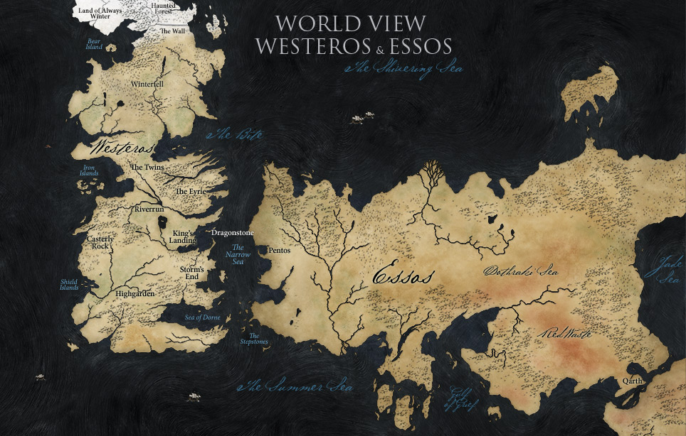
A Song of Ice & Fire
A brief Overview of The Geography of Westeros

Slide 2

Intended Audience
Anyone interested in gaining deeper knowledge of Game of Thrones

Slide 3
Data Visualization Information
QUESTIONS:
WHAT ARE THE REGIONS IN WESTEROS?
WHICH HOUSES BELONG IN WHICH REGION & HOW MANY HOUSES ARE THERE?
WHICH REGION IS WHICH?
HOW ARE THE REGIONS POSITIONED IN WESTEROS?

Slide 4
NODE NETWORK LINKED TO MAP
Users can interact in an artistic way with the data. It’s simple to understand and fun to use.
Node Network:
The center nodes represent the larger regions within Westeros. The smaller nodes are the houses within each region. Hovering over the individual nodes will display its name. Hovering over the center nodes shows its corresponding location on the map.

Slide 5
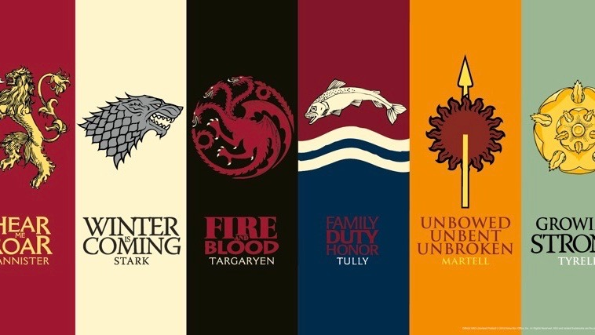
Information Learned by the User
Users will learn which houses belong in which region, therefore will have a better understanding when both the regions and houses are referenced in the show and/or books.

Slide 6
FINAL PROJECT: GOALS ACHIEVED vs. ROADBLOCKS MET
GOALS ACHIEVED
The node network works.
Successfully managed to contribute to one of my greatest personal passions.
ROADBLOCKS
Deconstructing the CARTO MAP into separate layers.
Realizing that in order to have the full effect, needed to get rid of more decorative layers.

